Slide 2
Types of Solids

Slide 3
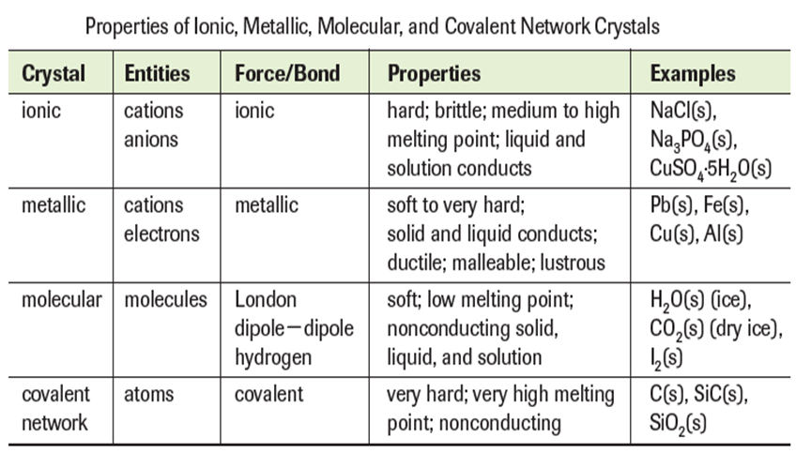
Properties of solids

Slide 4
Representation of Components in a Crystalline Solid

Slide 5
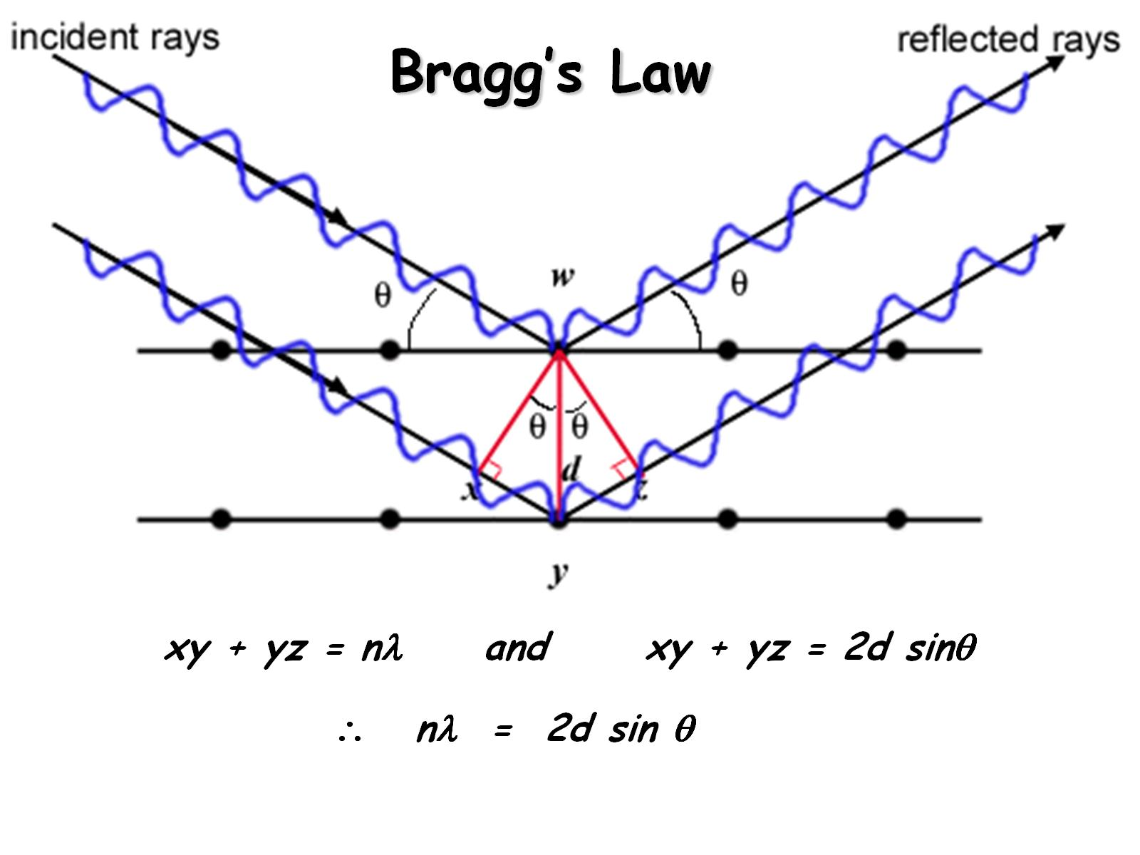
Bragg’s Law

Slide 6
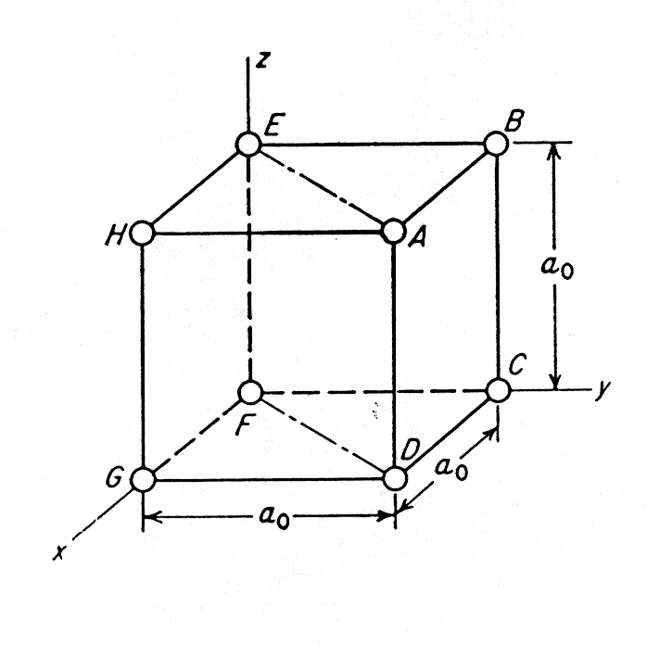
X-ray diffraction analysis shows that the atoms in a crystal are arranged in a regular, repeated three-dimensional pattern.
The most elementary crystal structure is the simple cubic lattice
Fig (a) Simple cubic structure.

Slide 7
We now introduce atoms and molecules, or “repeatable
structural units”.
The unit cell is the smallest repetitive unit that there are 14
space lattices.
These lattices are based on the seven crystal structures.
The points shown in Figure (a) correspond to atoms or groups of atoms.
The 14 Bravis lattices can represent the unit cells for all
crystals.

Slide 8
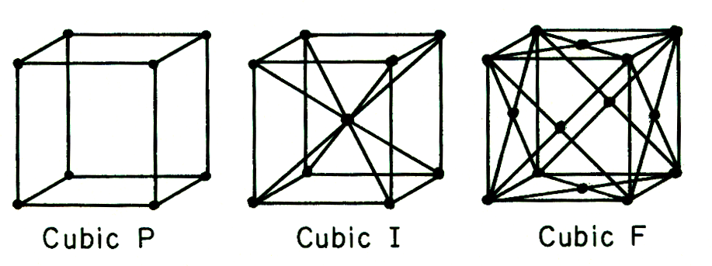
Figure (b) The 14 Bravais space lattices (P = primitive or simple; I = body-centered cubic; F = face-center cubic; C = base-centered cubic

Slide 9
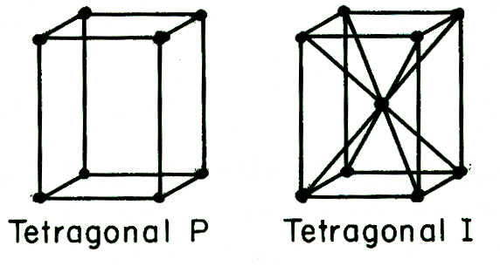
Figure (c)

Slide 10
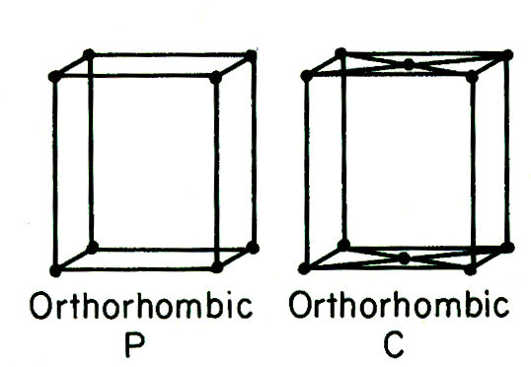
Figure (d)

Slide 11
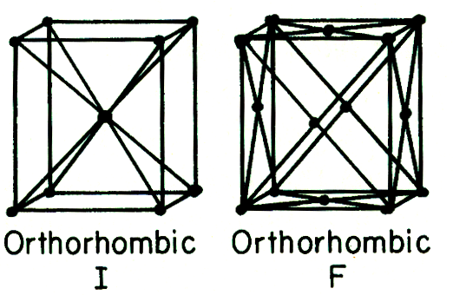
Figure (e)

Slide 12
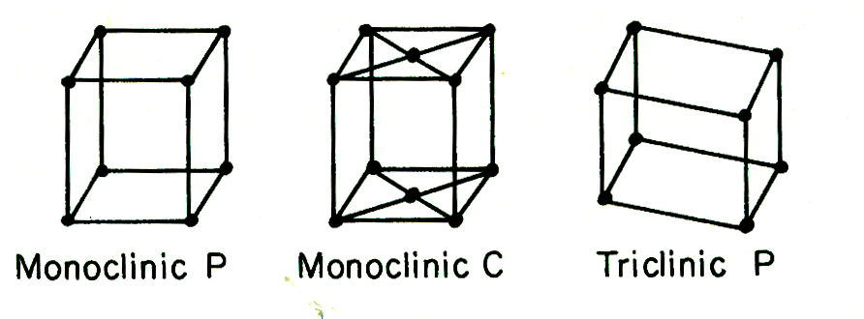
Figure (f)

Slide 13
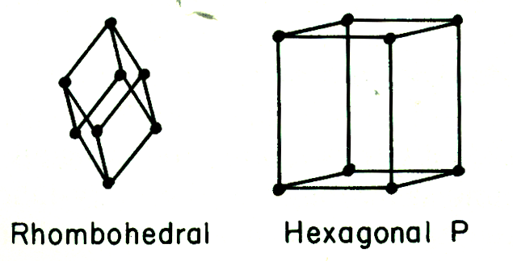
Figure (g)

